Slide 1
B.O.S.S
BRINGING OPPORTUNITIES, SUPPORT, AND SERVICES TO UPLIFT PEOPLE
Brenda Chan, Anzel de Asis and Marga San Juan
Ube
Agency

Slide 2
AGENDA
Marketing Objectives
Target Audience
B.O.S.S. Pain Point/Problem
Proposed Solution
Tactics and Strategies
Budget and Resource Utilization
Timeline
Expected Outcomes and Metrics
Conclusion
Ube
Agency

Slide 3
THE MAIN GOAL...
Is to boost the money that B.O.S.S. generates, so that B.O.S.S. can continue doing what it does best: Helping people.
So how can we get there?
Ube
Agency
Ube Agency

Slide 4
MARKETING OBJECTIVES
Increase Awareness
Establishing Identity
Strengthening Community
Driving Engagement
Keeping BOSS top of mind
Who is BOSS?
The Online Space
Focusing on Individuals
It’s not only important to get BOSS’s name out there but to establish a strong and positive personality with it as well. Our objective is to create ways that not only grow exposure and donations but to establish familiar and personal associations with the organization.
One of the most important factors in marketing a charitable organization is to make its unique mission and approach apparent. A vibrant online presence and bite-sized, shareable posts can drive more awareness and interest in BOSS.
With SF’s vibrant history and community, there are many robust organizations dedicated to serving the city and surrounding area. We want to make sure BOSS stands out as a leading organization paving the way in providing equitable, holistic, and supportive services, especially in the Bay Area.
Through our proposed methods, a larger emphasis will be placed on individuals important to BOSS, whether it be beneficiaries, donors, or volunteer workers. Putting stories and names to faces can increase personal investment in the organization and encourage more donors to donate.
Ube
Agency
Ube Agency

Slide 5
MARKETING OBJECTIVES
Achieving the above objectives will ensure that B.O.S.S. is memorable, impactful, and profitable.
We’re not only raising money, but forming a long-term, respectful, and genuine connection with both donors and benefactors.
Ube
Agency
Ube Agency

Slide 6
TARGET AUDIENCE
Primary Target Audience: Donors
From affluent and influential communities
Empathetic and charitable
Steady money flow
Strong Women and those from under represented backgrounds such as POC, possibly politicians, to bring support back to communities who need it
Large companies interested in helping their communities or holding charity events
B.O.S.S. works with a variety of donors. The target we have identified here personifies values of generosity, passion, and representation, whose generous donations will help boost the organization’s capacity for good.
Ube
Agency
Ube
Agency

Slide 7
TARGET AUDIENCE
Secondary Target Audience: Benefactors and supporters
Average community members wanting to contribute and be updated on community events and efforts
Individuals in their 20s making comfortable income who can contribute small but consistent donations
Those who may benefit from B.O.S.S’s services
Anyone is welcome to be a part of B.O.S.S. in every capacity, whether it be through a $3 donation, volunteering at events, or simply supporting social media pages. We want to highlight that anyone anywhere can help and still make a difference.
Ube
Agency
Ube
Agency

Slide 8
B.O.S.S. PAIN POINT/PROBLEM
Limited exposure and social media presence, leading to limited funding; a new goal set to increase money raised to $250,000 in 2025.
Ube
Agency
Ube Agency
Notes:
Already knowing that B.O.S.S currently has over 2700 followers on Instagram, there is still a lack of engagement on social media platforms. We want to drastically increase this with a new audience of sponsors that can help us reach our goal to help more people in need.

Slide 9
PROPOSED SOLUTIONS
For galas, bring back those who have benefitted from B.O.S.S. to speak on their growth and successes since first working with the organization.
For YouTube, have a consistent interviewer who goes to those who are being helped or have been helped in the past to elaborate on B.O.S.S.’s help. The use of pathos can sway and bring in contributors or sponsors. Suggested posting rate would be at least twice a month, as well as utilizing hashtags when uploading onto TikTok to build a bigger audience. The style of videos could be similar to MTV cribs, with an interviewer going around asking 50 questions, instead asking how B.O.S.S. has helped them over time.
Partner with SF-based organizations that know the community best, such as United Playaz, a violence prevention and youth development organization who have featured known figures such as Steph Curry and Colin Kaepernick.
Ube
Agency
Ube
Agency

Slide 10
PROPOSED SOLUTIONS
The quality of an event trumps the quantity of events thrown. When integrating content into galas that increase personal investment and belief in the effectiveness of B.O.S.S., it will be easier to sway donors to continue donating.
A more organized and prevalent online presence increases reach, exposure, and credibility, which would greatly boost the likelihood of legitimate donors finding and donating to B.O.S.S.
Collaborations help further exposure and build connections, especially within the non-profit charity space. United Playaz, the provided example, has
done many collaborations in the past with other Bay Area
organizations.
Ube
Agency
Ube
Agency

Slide 11
MARKETING TACTICS AND STRATEGIES
Social Media
Gala Planning
Targeting and retargeting strategies will help BOSS advertise to an intentional and effective audience, and to remind and re-expose interested viewers to more content and important events
Budget allotments to increase the quality and quantity of BOSS content will help grab attention, build the brand identity and story, and allow interested viewers to find more content about BOSS easily.
Ticket prices for gala events will help go toward the event planning as well as revenue toward BOSS’s charitable causes.
A well-coordinated gala has the chance to show donors and potential donors the personal impact of their contributions and also to uplift and feature voices and individuals whose lives were positively impacted by BOSS.
Additional auctions and games will be present for added revenue.
Coordination and Streamlining
The unique idea behind BOSS is that they hope to build a future wherein their services will no longer be needed. This forward-thinking, overarching idea is a unique and genuine insight that sets BOSS apart from regular organizations. Highlighting this in content, events, and messaging will draw more eyes towards their efforts.
Ube
Agency
Ube Agency

Slide 12
YOUTUBE DEVELOPMENT SAMPLE GUIDE
Media Kit
A media kit document should be made outlining graphic design specifics, such as B.O.S.S. colors, fonts, and logos. This creates consistency and memorability in branding.
Specialized posts made to fit the quirks and perks of each platform; specific teams and goals need to be customized depending on whether the post or media material is meant for a TikTok, a twitter post, an Instagram promotional post, or a facebook post.
A set tone for captions and copywriting should be adhered to. Specific taglines, hashtags, and other related items should also be included in the media kit to be referenced in posts.
Set Schedule
Uploads should be consistent but not bombard viewers. Twice of thrice a week depending on the season and upcoming events is a good target. If B.O.S.S. makes a promotional post on one platform, wait a buffer day to post it on the other platforms to ensure the most effective window for exposure.
Ube
Agency
Ube Agency

Slide 13
BUDGET AND RESOURCE UTILIZATION
$25,000-$50,000
Ube
Agency
Ube
Agency

Slide 14
TIMELINE
Month 1
Month 2
Month 3
Month 4
Month 5
Content Creation & Strategy
Growth & Engagement
Gala Promotion & Livestream
Post-Gala Follow-Up
Refinement & Long-Term Engagement
Launch organic & paid campaigns, focus on stories and giveaways.
Heavy promotion, engagement, and gala execution.
Share event highlights, re-engage donors, evaluate results.
Adjust campaigns, sustain engagement, plan future activities.
Develop content, ads, and partnerships.
Ube
Agency
Ube
Agency

Slide 15
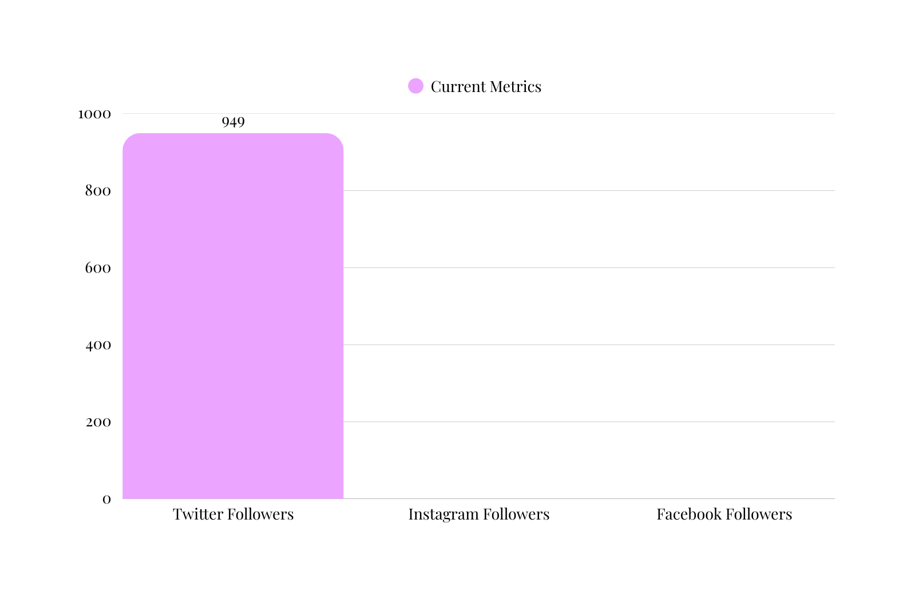
Gala
200 Attendees
($100)
EXPECTED OUTCOMES
& METRICS
$20,000
+
10,000 online outreach
$1 -$25
=
Projected Total Revenue
$150,000 - $250,000
Ube
Agency
Ube
Agency

Slide 16
CONCLUSION
Join us in revolutionizing ways to increase our funds to help more than a few hundred people out. Let’s work together to find the right sponsors who are willing to go above and beyond to increase self sufficiency to all that are suffering in silence.
Ube
Agency
Ube
Agency

Slide 17
Thank you!
QUESTIONS?
Ube
Agency
Ube Agency

